Slide 1
Gen AI & Classic ML
when to use what
July 2024
Felix Wick

Slide 2
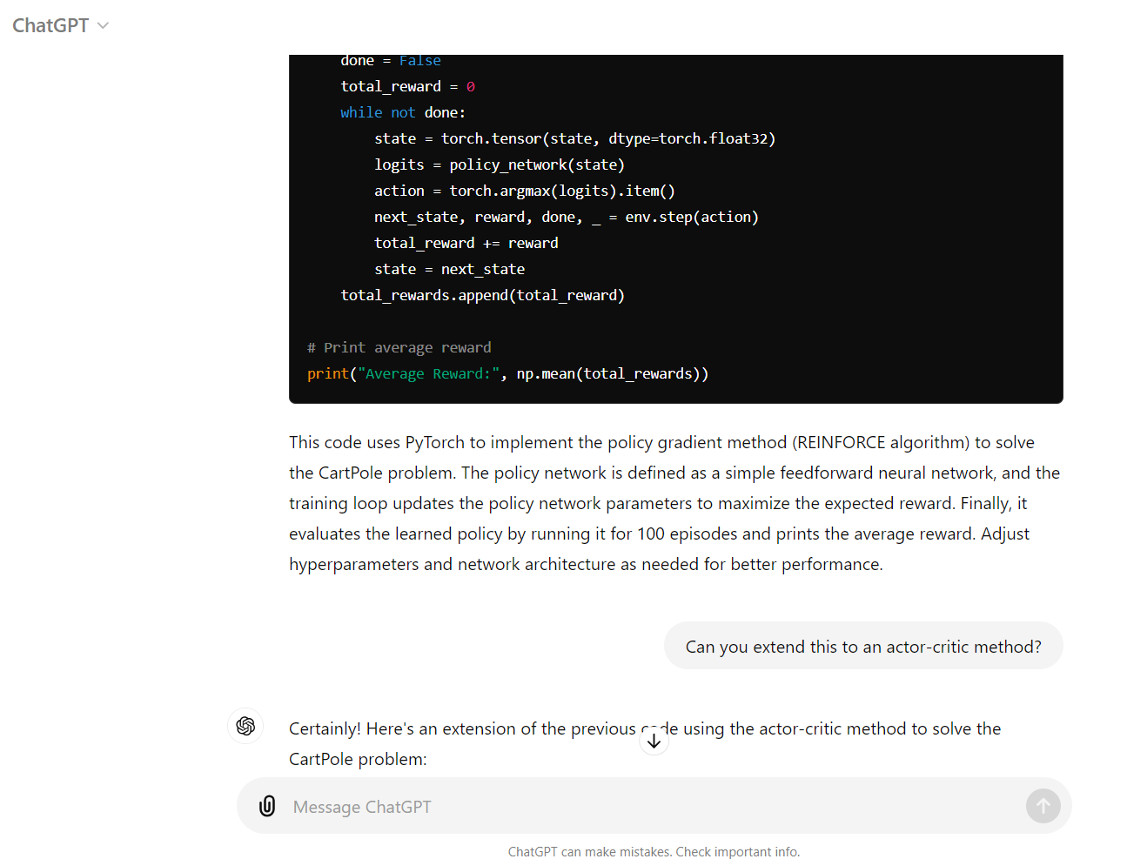
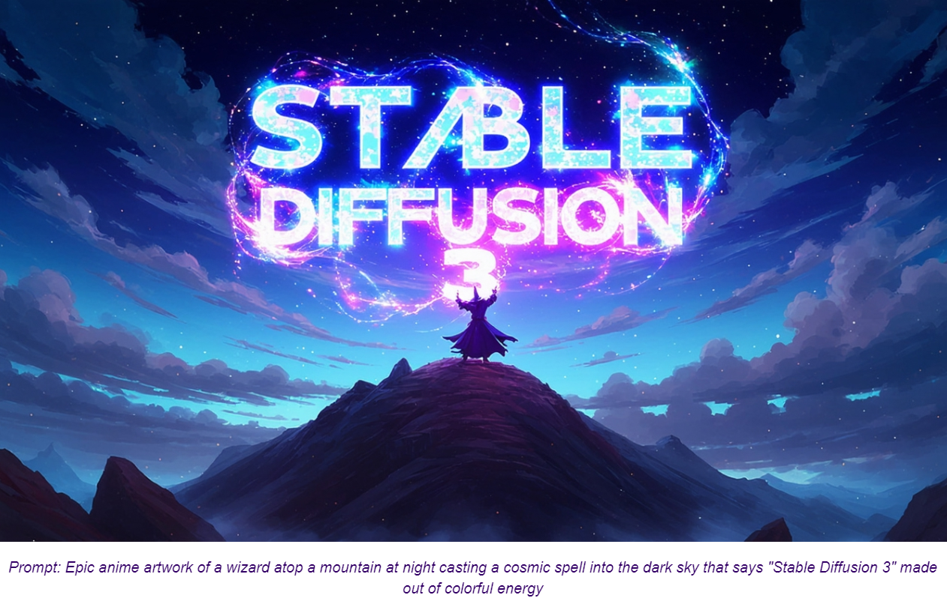
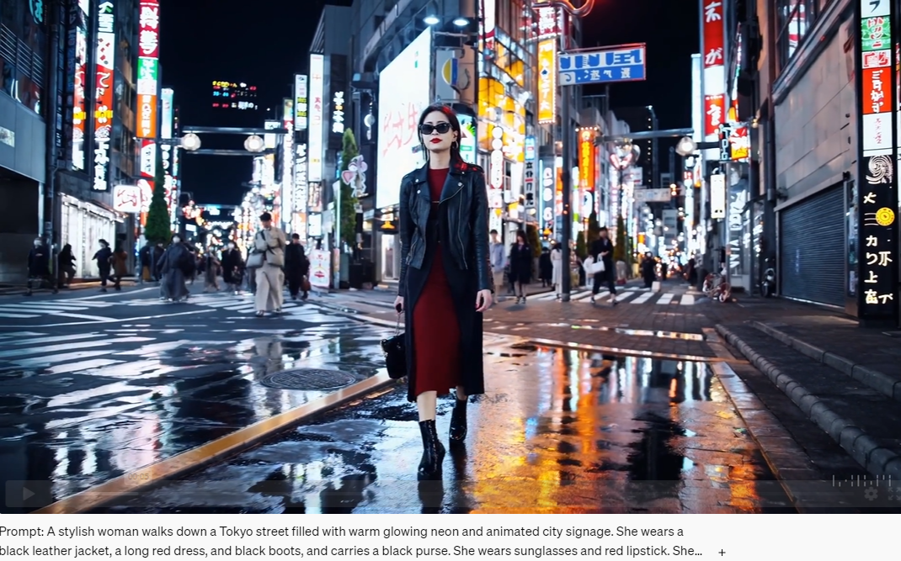
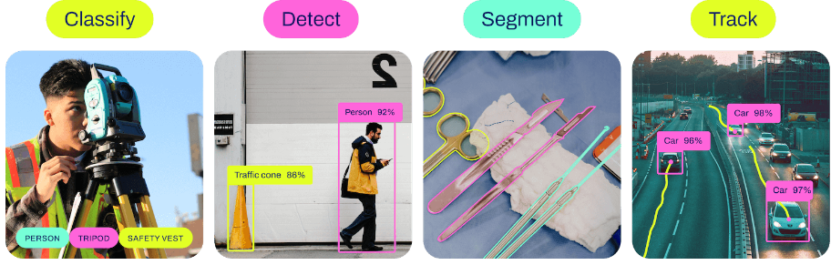
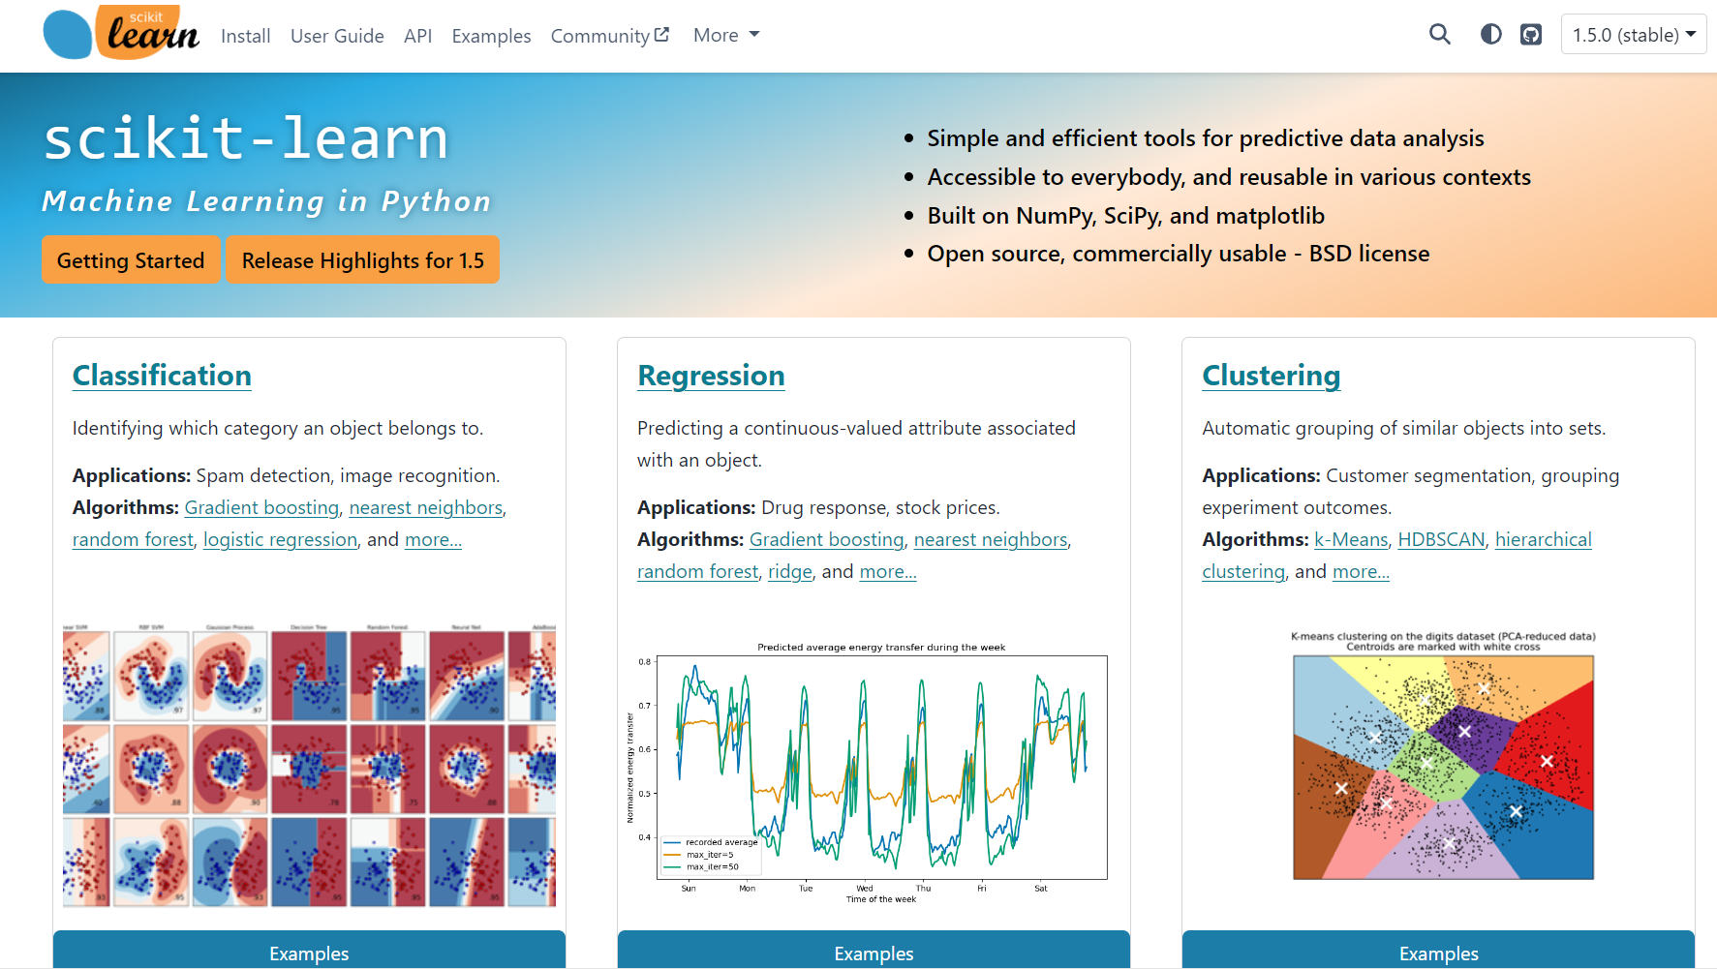

Classic ML vs Deep Learning
Generative vs Predictive Models
text generation
image synthesis
text-to-video
ChatGPT
Stable Diffusion 3 — Stability AI
Sora | OpenAI
BERT family
tabular data
computer vision
YOLO

Slide 3


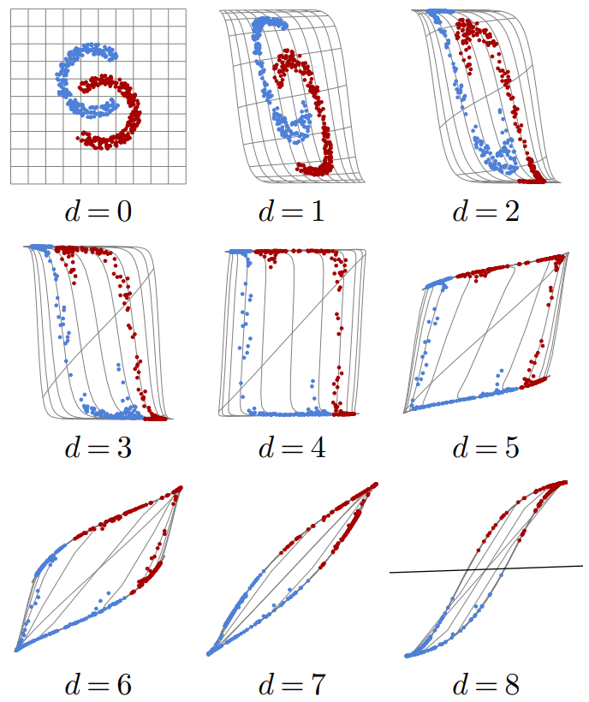
Ladder of Generalization
classic ML: feature engineering
deep learning: feature learning
(hierarchy of concepts learned from raw data in deep graph with many layers)
source
source
source

Slide 4
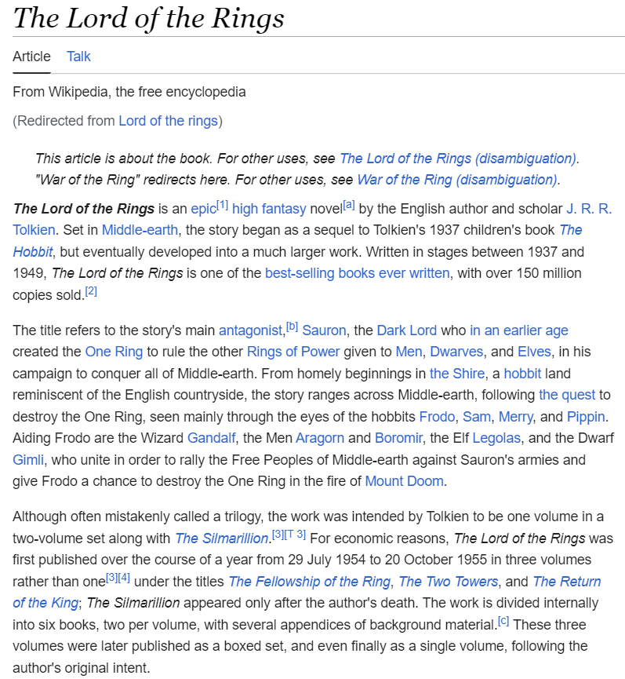
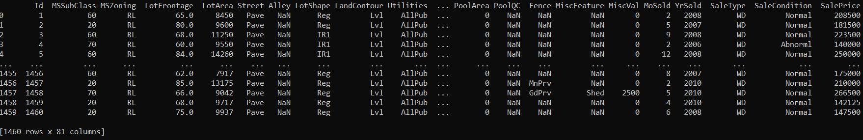
Structured/Tabular vs Unstructured Data
unstructured data: homogenous
→ deep learning rules
→ allows transfer learning (foundation models in CV and NLP)
structured data: heterogenous
→ feature engineering needed
deep learning loses its advantage over shallow methods
→ e.g., gradient boosting still used a lot
ImageNet

Slide 5
Transfer Learning
idea:
generic pre-training of foundation models on huge data sets
subsequent fine-tuning for specific tasks on small(er) data sets
(usually done with deep learning methods, using its compositional nature)
very successful for:
computer vision (e.g., object classification)
language models (e.g., BERT, GPT)
not (yet) for tabular data (due to its notorious heterogeneity)

Slide 6
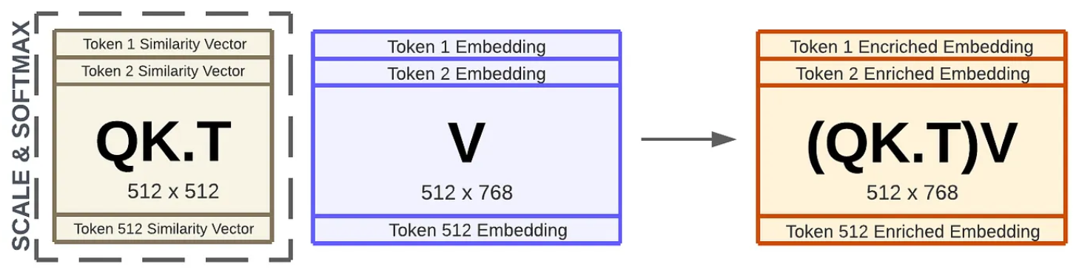
Language Models: Contextual Semantics
self-supervised learning: e.g., next/masked-word prediction
tokenization: split text into chunks (e.g., words)
semantics by means of vector embeddings: e.g., via bag-of-words (or end-to-end in transformer)
positional encoding & embeddings: order of sequence
contextual embeddings: (self-)attention (weighted averages: influence from other tokens)
source

Slide 7

Encoder vs Decoder LLMs
all new LLMs decoder-only
encoder-only LLMs
prime example: BERT
self-supervised pre-training: masked-word prediction
fine-tuning on downstream tasks (e.g., sequence classification)
can’t generate text
can’t be prompted
decoder-only LLMs
prime example: GPT
self-supervised pre-training: next-word prediction
instruction tuning (e.g., RL from human feedback)
generate text: chat bots
prompt engineering
aka causal
source

Slide 8

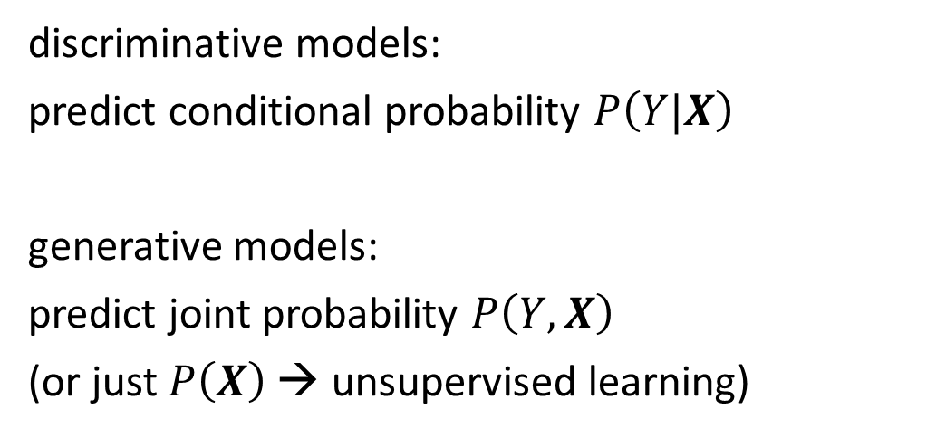
Generative vs Predictive/Discriminative Models
discriminative model
generative model
discriminative models:
predict conditional probability $P\left(Y|X\right)$
generative models:
predict joint probability $P\left(Y,X\right)$
(or just $P\left(X\right)$ → unsupervised learning)
source
task of generative models more difficult: need to model full data distribution rather than merely find patterns in inputs to distinguish outputs
generative models allow to generate new data samples (text, images, video, proteins, …)
predictive models usually better for predictive tasks, business problems often specific/predictive

Slide 9
Deep Learning for Generative AI
Depending on the application, there are currently two dominant approaches for generative AI:
text generation: decoder LLMs
image synthesis: diffusion models
note the difference between image synthesis and multimodal understanding in LLMs (images as additional input sequences to transformer, tokenized by splitting into patches)

Slide 10

Image Synthesis
example: DALL-E 2
idea: generate new images as variations of training data
usually conditioned on text (prompt) by transformers
compared to text generation, additional mechanism needed (e.g., diffusion) to create more complex structures

Slide 11
Text Generation
in-context learning as alternative to fine-tuning (new paradigm):
feed information into LLM via input prompt (decoder LLMs)
→ attention to context
typical prompt:
instructions, context (potentially retrieved), query, output indicator
enables multi-task capabilities (all of ML before was only narrow tasks)
→ assistants

Slide 12
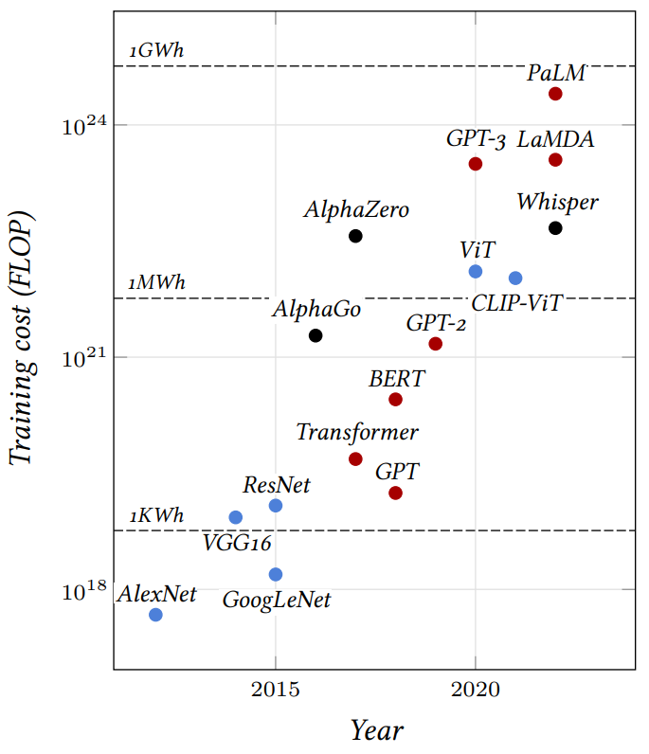
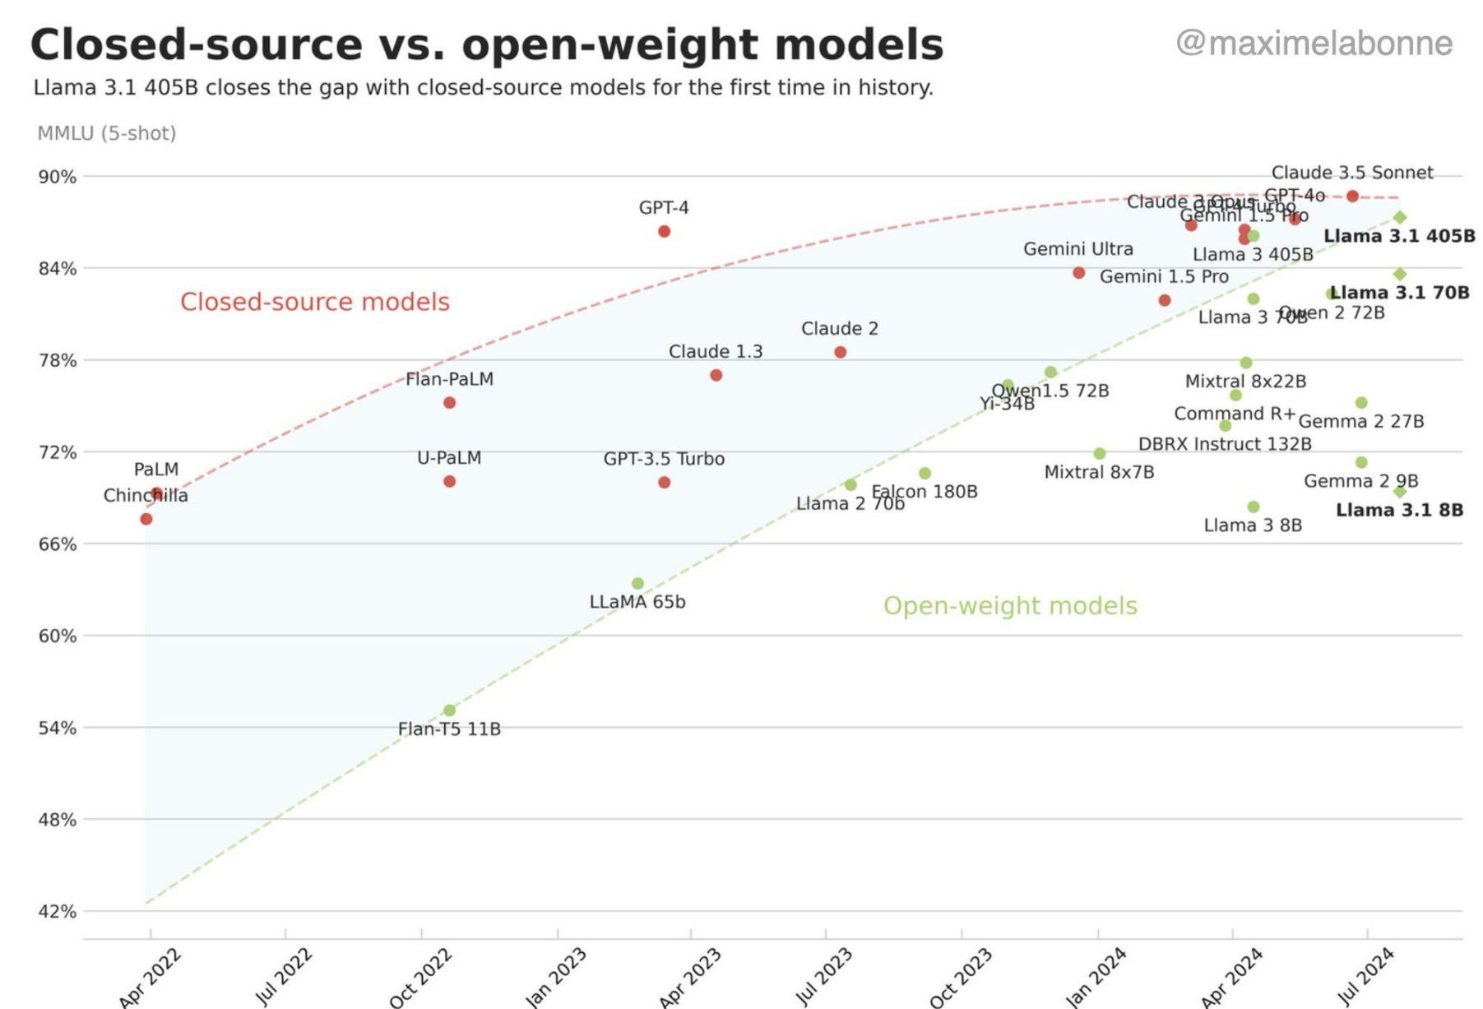
(open-source) SOTA (July 2024):
Llama 3
a few surveys: 1, 2, 3
source

Slide 13
Some LLM Numbers
example Llama 3 405B:
vocabulary size (tokens): 128K
embedding/model dimensions: 16,384
parameters: 405B
training tokens: 15.6T
context length/window (tokens): 128K
training hardware: 16K GPUs (H100)
factor less than 40
→ a lot of memorizing

Slide 14
LLM Agents
current AI good at learning statistical patterns and making predictions
but no real “understanding”, and limited reasoning and planning capabilities
desired agent capabilities:
planning (LLM: decomposition of complex issue in multiple simple steps)
tool use (LLM: use predictive models for numerical/optimization tasks)
reflection
collaboration with other agents

Slide 15
Goal: Autonomous End-to-End Workflow
LLM/VLM agent
RAG
tool usage
control
domain knowledge
prediction, optimization
decision making
input
input
perception

Slide 16
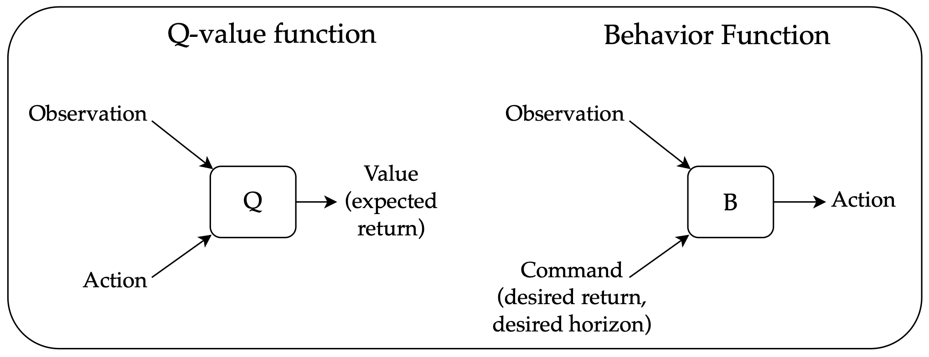
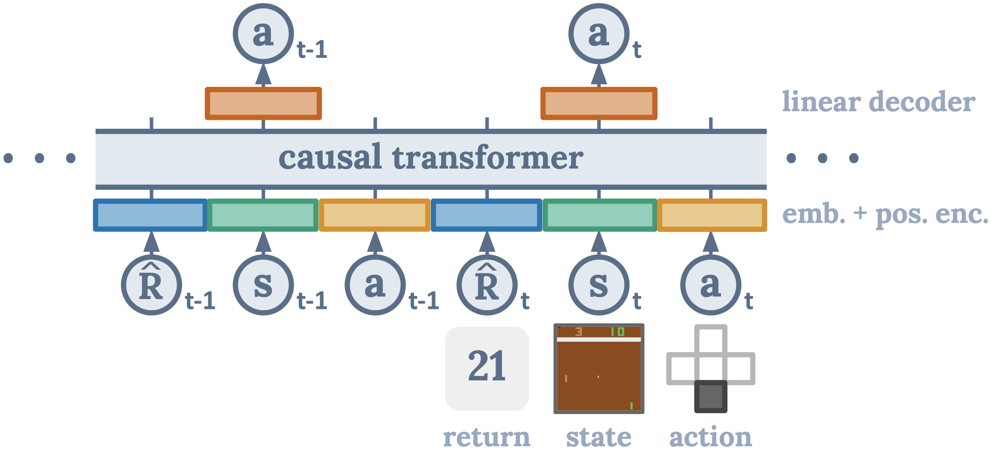
Sequential Decision Making
typically, domain of reinforcement learning
sequence modeling as alternative:
generative: transformer decoder to autoregressively model trajectories
credit assignment directly via self-attention: state-return associations
desired return tokens as prompt for action generation
overcoming the deadly triad of deep RL:
Decision Transformer:
source
source

Slide 17
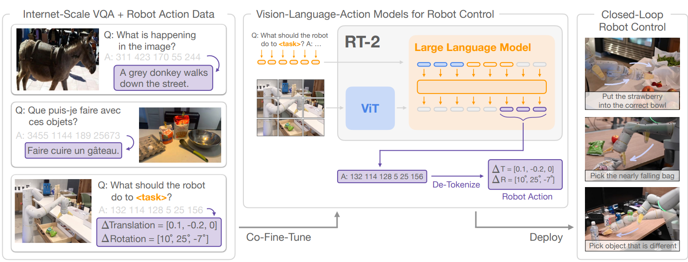
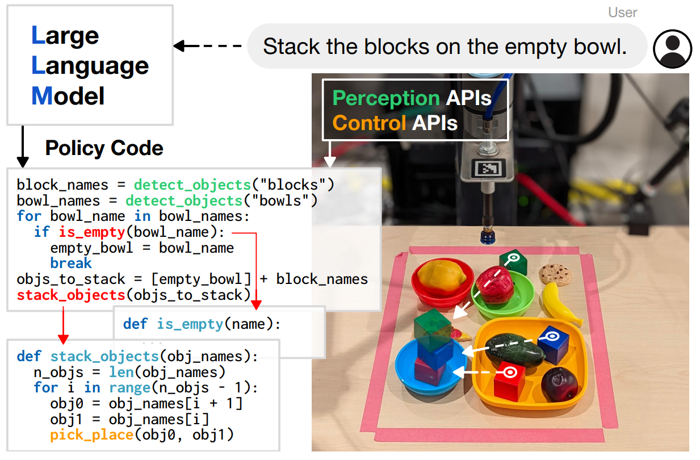
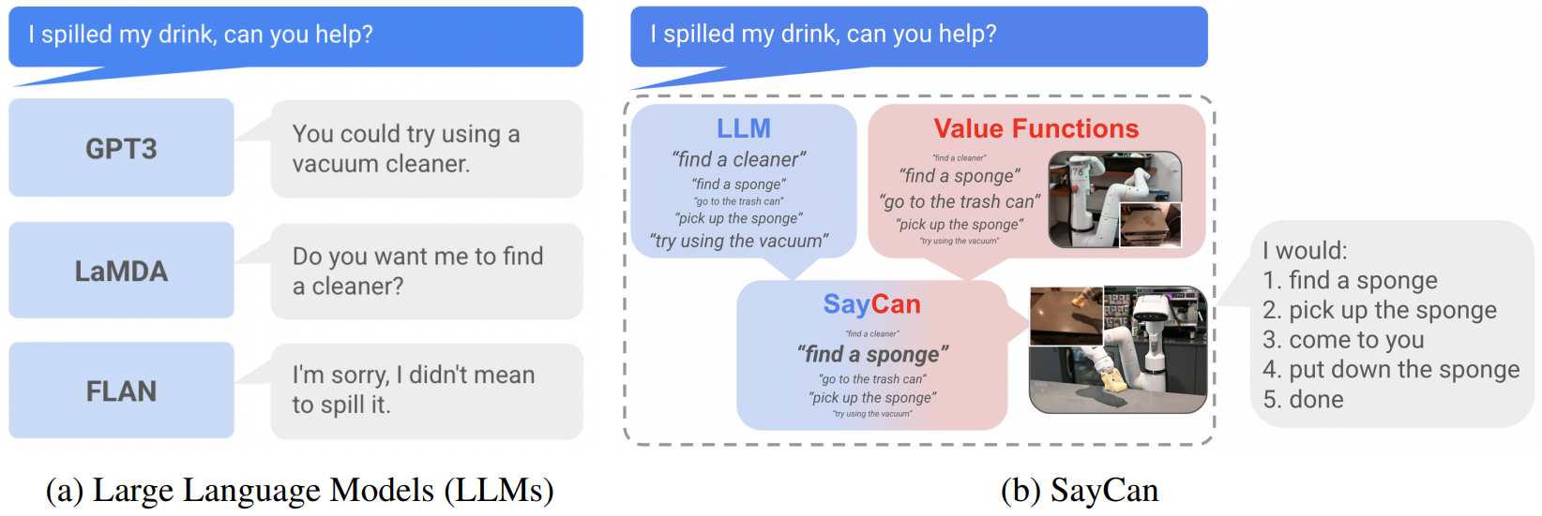
Robotic Control generated by LLMs/VLMs
RT-2:
Code as Policies:
SayCan (grounding with pre-trained skills):

